Slide 1

TRAVEL BUDDY: TRAVEL RECOMMENDATION SYSTEM
SUMMER INTERNSHIP GROUP PROJECT

Slide 2

OUR TEAM
TANIHSKA SINGH
KARVY SINGH
HARSHIT SHUKLA
JAYANT SINGH
PRASOON SHARMA
GROUP 7

Slide 3
TRAVELER CHALLENGES IN FINDING RELEVANT DESTINATIONS
OUR GOAL:
RECOMMEND PERSONALIZED TRAVEL DESTINATIONS USING TEXT AND NUMERIC FEATURES (LIKE RATINGS, DURATION).
Travelers often find it overwhelming to search for suitable tourist spots due to the abundance of options available. The diversity in preferences and lack of personalized suggestions further complicates their decision-making process.

Slide 4
MODEL OBJECTIVE FOR TOURIST SPOT RECOMMENDATIONS
OUR GOAL:
RECOMMEND PERSONALIZED TRAVEL DESTINATIONS USING TEXT AND NUMERIC FEATURES (LIKE RATINGS, DURATION).
The primary goal of this model is to create tailored recommendations for tourists based on descriptive data of attractions and the ideal duration for visits. It aims to enhance user experience by providing relevant suggestions that align with individual preferences and needs.

Slide 5



WORK FLOW
Raw Dataset
Data Preprocessing
TF-IDF
Numeric Scaling
Feature Engineering
Model: XGB
Model Evaluation
Top-N Recommendations

Slide 6
DATASET OVERVIEW
Source File: famous_indian_tourist_places_3000.jsonl
Record Count: ~3,000
Key Fields:
city name, place name, place description, city description, Best time to visit(text fields)
ratings of place (1–5 scale)
ideal duration of duration,Distance from city (numeric fields)

Slide 7
DATA PREPROCESSING
TEXT PROCESSING:
Combined: place_desc + city_desc
Other text fields- best_time_to_visit, city,place, distance
Converted to TF–IDF (max 15,000 features)
Numeric Handling:
Parsed ideal_duration (e.g. "2-4" → 3.0)
Scaled features
ratings_place, ratings_city which are used for prediction purposes

Slide 8
FEATURE ENGINEERING
Final Data Matrix:
Text: TF–IDF vector (sparse)
Numeric: duration, etc.
Stacking: Combined into sparse matrix of shape (~3000 × 15002)
Visual: Simple block diagram showing vector conversion and stacking

Slide 9
MODELLING APPROACH
Model: XGBoost Regressor:
Handles large sparse-dense feature matrices
Scalable, accurate
Training Setup:
80/20 train-test split (random_state=42)

Slide 10
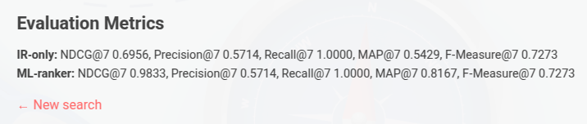
EXAMPLE EVALUATION METRICS

Slide 11
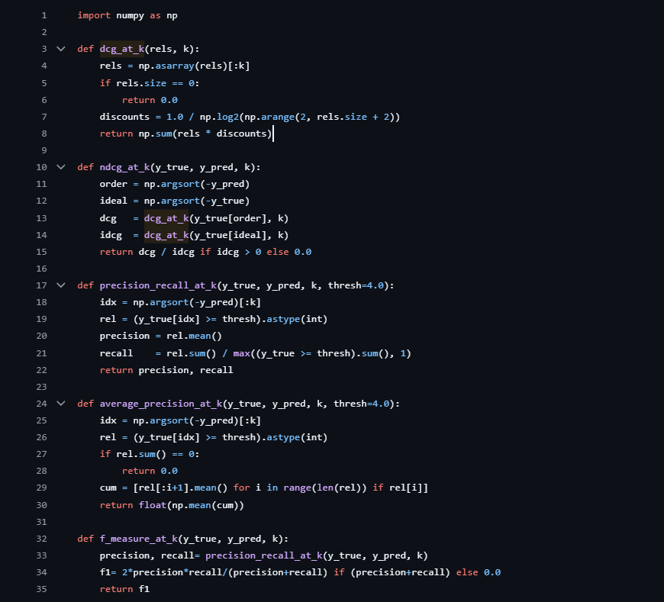
EVALUATION METRICS CODE

Slide 12
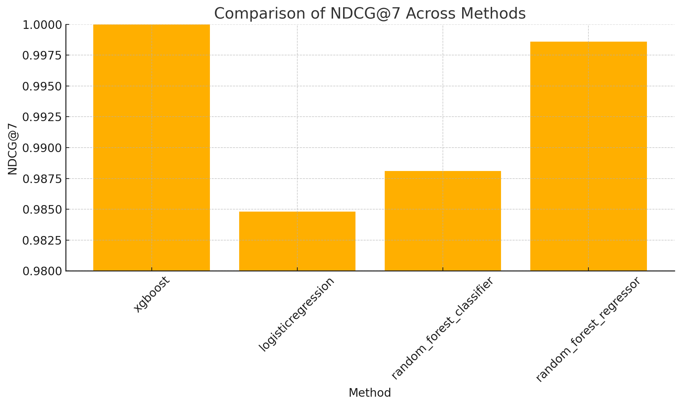
Choosing Our Model
NDCG: Quality of ranking

Slide 13
FUTURE ENHANCEMENTS
More fields like Budget can be added for ml re-ranking
More varied filters can be added filters
Use of Fields like distance from city can be brought into use.
What we missed right now, will complete till 7 july:
Deployment
Beautification of flask application

Slide 14
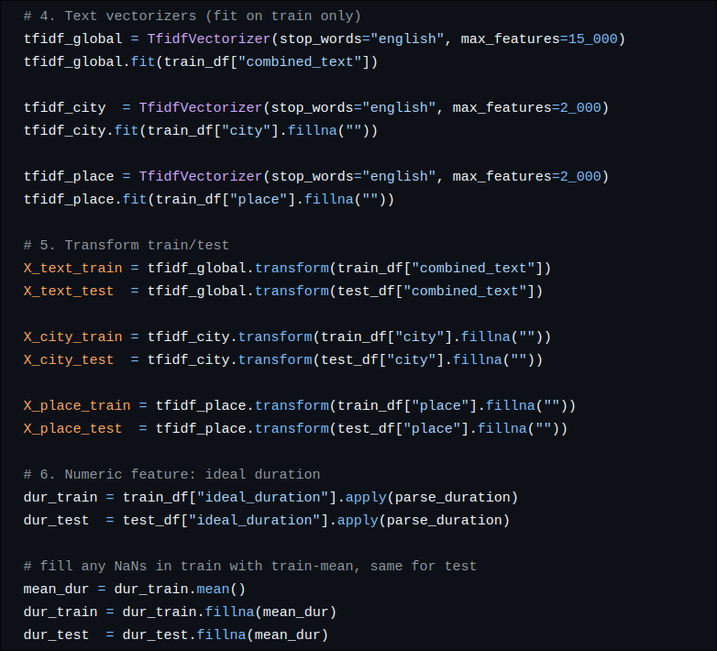
DEMO & CODE

Slide 15
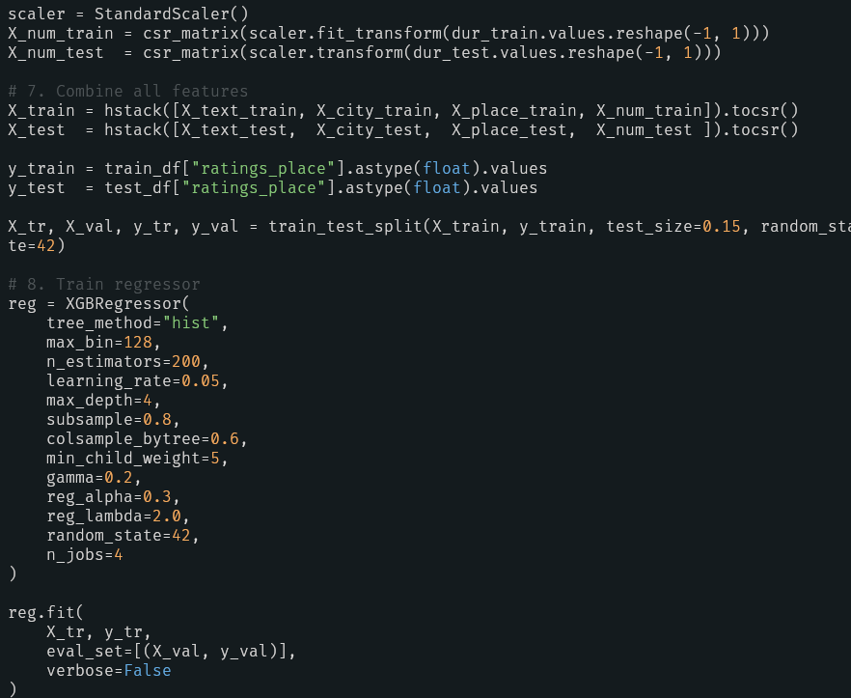
DEMO & CODE

Slide 16
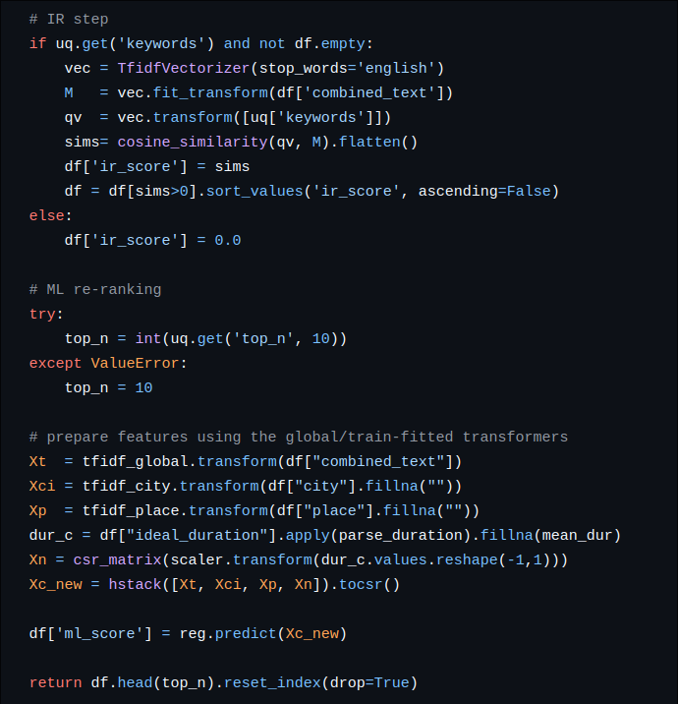
DEMO & CODE

Slide 17
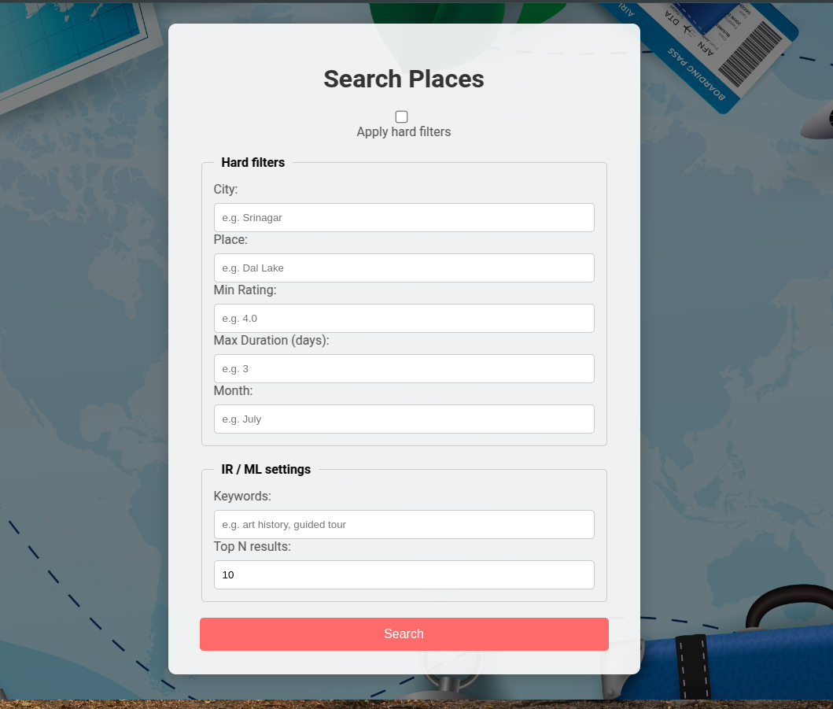
DEMO & CODE

Slide 18
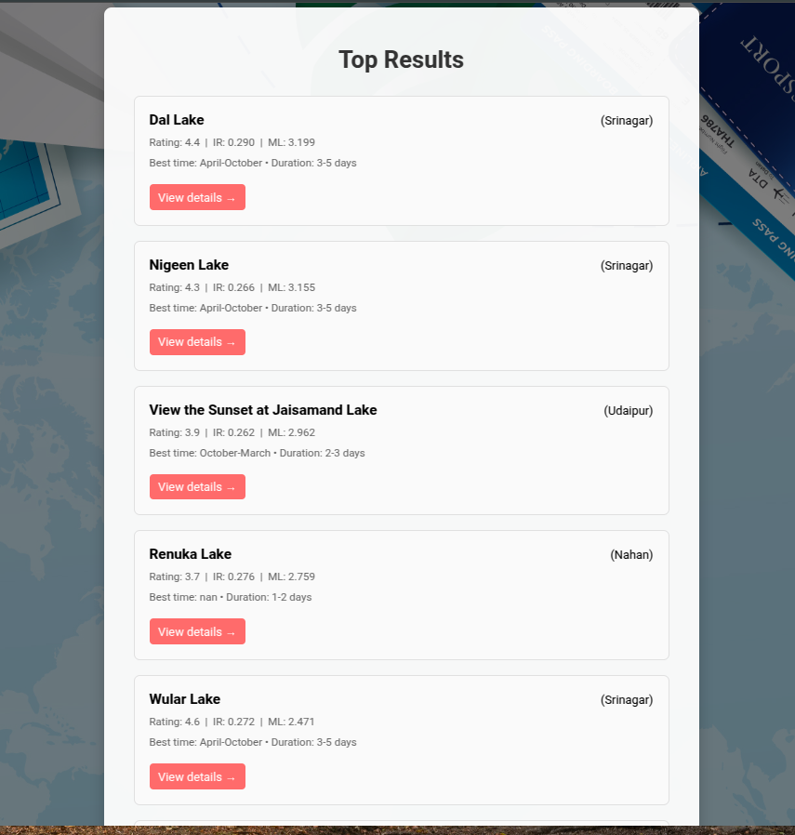
DEMO & CODE

Slide 19
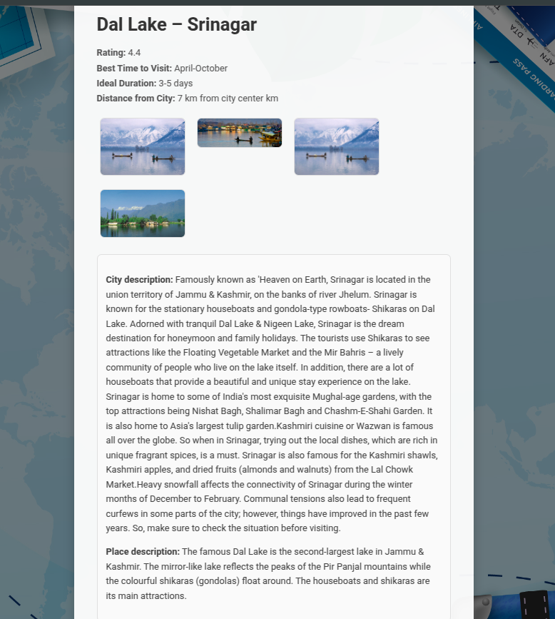
DEMO & CODE

Slide 20
Q&A

